Slide 1

Machine Learning
Lecture 2
Dr. Muhammad Kamran Malik

Slide 2
Supervised Machine Learning

Slide 3
What is Supervised Machine Learning
Supervised learning is the types of machine learning in which machines are trained using well "labelled" training data, and on basis of that data, machines predict the output.
The labelled data means some input data is already tagged with the correct output.
In supervised learning, the training data provided to the machines work as the supervisor that teaches the machines to predict the output correctly.
It applies the same concept as a student learns in the supervision of the teacher.

Slide 4
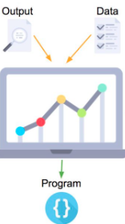
What is Supervised Machine Learning
Supervised learning is a process of providing input data as well as correct output data to the machine learning model.
The aim of a supervised learning algorithm is to find a mapping function to map the input variable(x) with the output variable(y).

Slide 5
Types of Supervised Learning

Slide 6
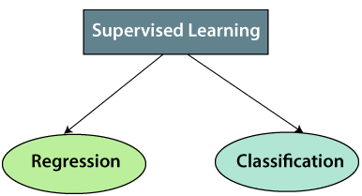
Types of Supervised Learning

Slide 7
Types of Supervised Learning (Regression)
Regression algorithms are algorithms are used when the output variable is continuous variables, such as Weather forecasting, Market Trends, etc.
Below are some popular Regression algorithms which come under supervised learning:
Linear Regression
Regression Trees
Non-Linear Regression
Bayesian Linear Regression
Polynomial Regression, etc.

Slide 8
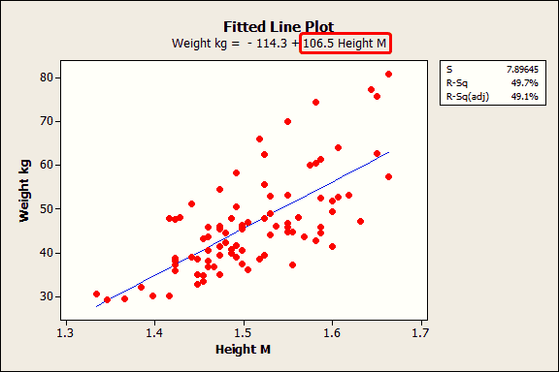
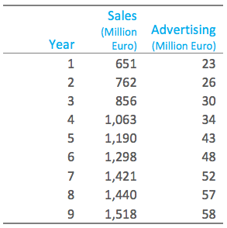
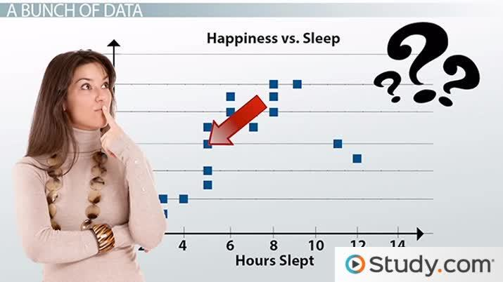
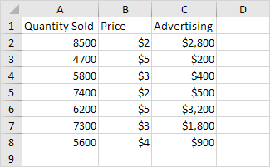
Regression Example

Slide 9
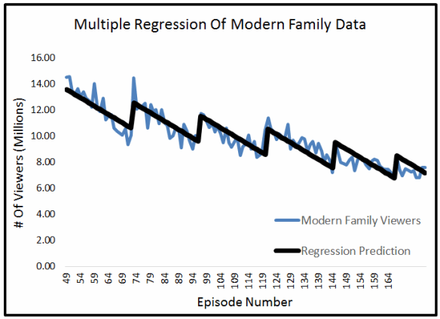
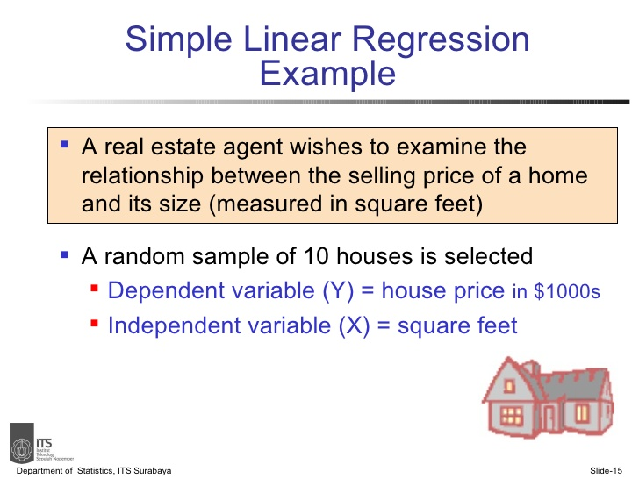
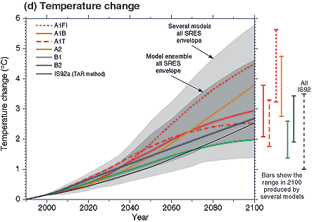

Regression Example

Slide 10
Types of Supervised Learning (Classification)
Classification algorithms are used when the output variable is categorical, which means there are two classes such as Yes-No, Male-Female, True-false, etc.
Naïve Bayes
Random Forest
Decision Trees
Logistic Regression
Support vector Machines etc

Slide 11
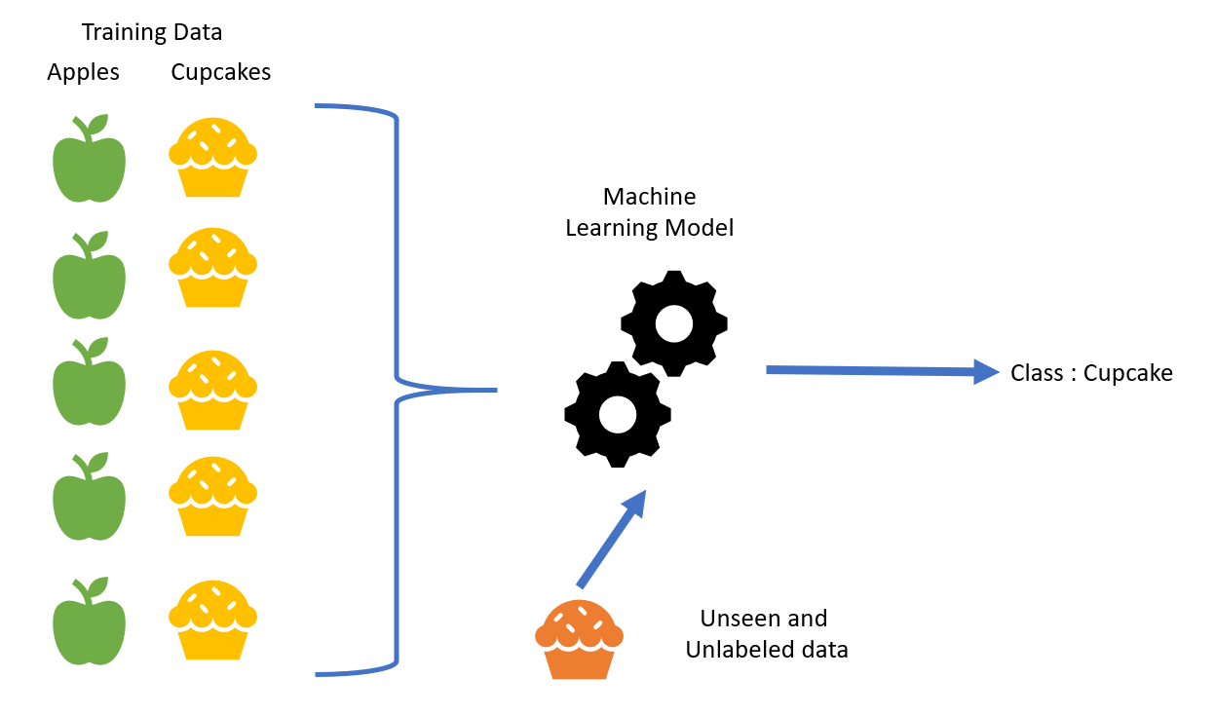
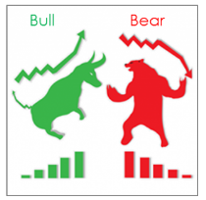
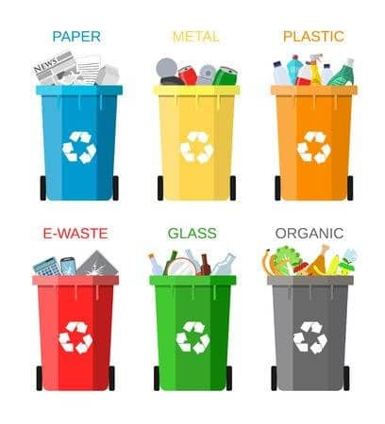
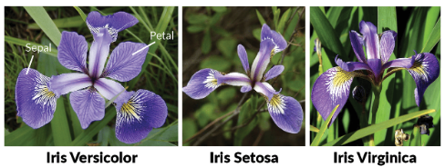
Classification Example

Slide 12
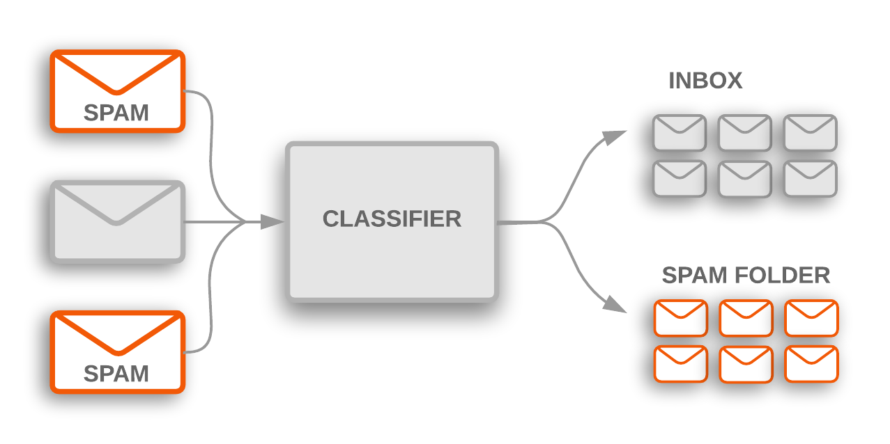
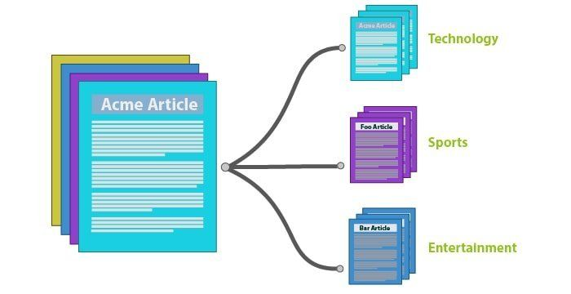
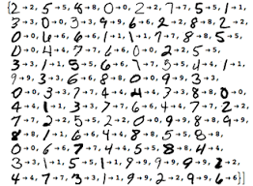
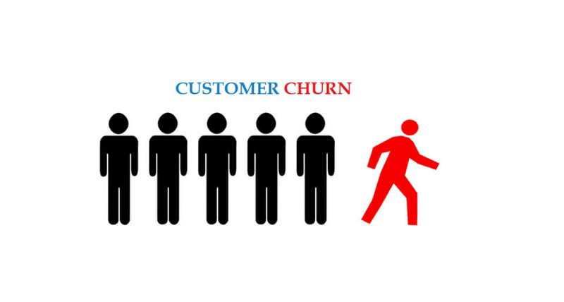
Classification Example

Slide 13
Q & A

Slide 14
How Supervised Learning Works

Slide 15
How Supervised Learning Works?
First determine the type of problem
Collect the labelled data.
Split the dataset into training (80%) and testing (20%).
Determine the input features of the training dataset, which should have enough knowledge so that the model can accurately predict the output.
Determine the suitable algorithm for the model, such as support vector machine, decision tree, etc.
Execute the algorithm on the training dataset.
Evaluate the accuracy of the model by providing the test set. If the model predicts the correct output, which means our model is accurate.

Slide 16
How Supervised Learning Works?
First Determine the type of problem
Collect the labelled data.
Split the dataset into training, testing, and validation dataset.
Determine the input features of the training dataset, which should have enough knowledge so that the model can accurately predict the output.
Determine the suitable algorithm for the model, such as support vector machine, decision tree, etc.
Execute the algorithm on the training dataset. Sometimes we need validation sets as the control parameters, which are the subset of training datasets.
Evaluate the accuracy of the model by providing the test set. If the model predicts the correct output, which means our model is accurate.

Slide 17
How Supervised Learning Works?
Select problem
Collect the labelled data
Split the dataset into training, and testing
Evaluate the model on testing data
Determine the suitable algorithm
Determine input features
Train the algorithm on the training dataset

Slide 18
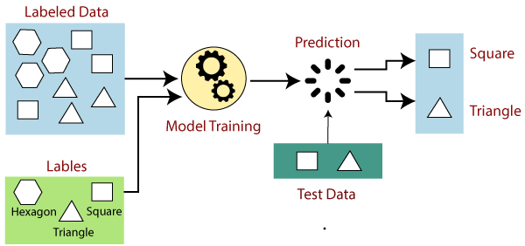
How Supervised Learning Works?

Slide 19
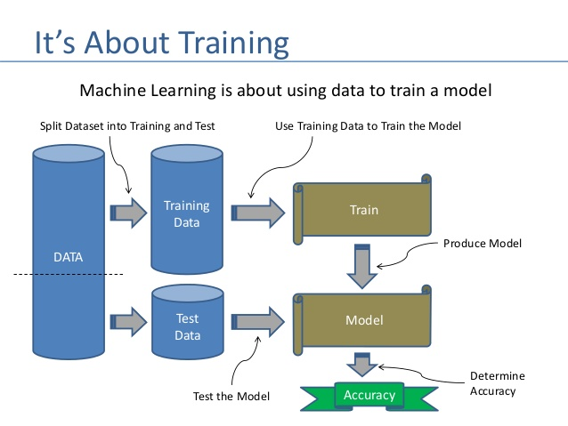
How Supervised Learning Works?

Slide 20
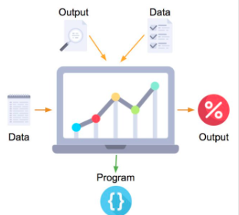
How Supervised Learning Works?

Slide 21
Q & A

Slide 22
Model Evaluation Measure

Slide 23
Model Evaluation Measures
True positives (TP): data points predicted/labeled as positive that are actually positive
False positives (FP): data points predicted/labeled as positive that are actually negative
True negatives (TN): data points predicted/labeled as negative that are actually negative
False negatives (TN): data points predicted/labeled as negative that are actually positive

Slide 24
Model Evaluation Measures
Accuracy: Closeness of a measured value to a standard or known value ((TP + TN)/(TP+TN+FN+FP))
Recall: ability of a classification model to identify all relevant instances (TP / TP + FN)
Precision: ability of a classification model to return only relevant instances (TP / TP + FP)
F1 score: single metric that combines recall and precision using the harmonic mean ( 2 (Precision * Recall)/(Precision + Recall))

Slide 25
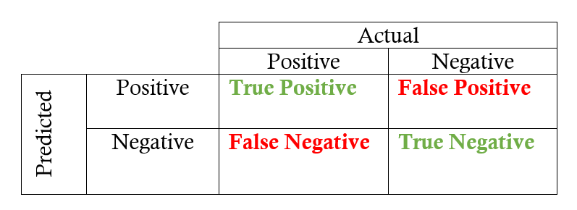
Model Evaluation Measures (Classification)
Images | Actual Label | Predicted Label
Image1 | Happy | Sad
Image2 | Sad | Sad
Image3 | Sad | Happy
Image4 | Happy | Happy
Image5 | Happy | Happy
Image6 | Sad | Happy
Image7 | Sad | Happy
Image8 | Happy | Happy
Image9 | Happy | Happy
Image10 | Sad | Sad
Accuracy = (TP + TN)/(TP+TN+FN+FP)
Recall = (TP / TP + FN)
Precision = (TP / TP + FP)

Slide 26
Model Evaluation Measures (Classification)
Images | Actual Label | Model 1 | Model 2
Patient1 | Not Corona | Not Corona | Not Corona
Patient2 | Not Corona | Not Corona | Not Corona
Patient3 | Not Corona | Not Corona | Not Corona
Patient4 | Not Corona | Not Corona | Not Corona
Patient5 | Not Corona | Not Corona | Not Corona
Patient6 | Not Corona | Not Corona | Corona
Patient7 | Not Corona | Not Corona | Corona
Patient8 | Not Corona | Not Corona | Corona
Patient9 | Corona | Not Corona | Corona
Patient10 | Corona | Not Corona | Corona
Accuracy = (TP + TN)/(TP+TN+FN+FP)
Recall = (TP / TP + FN)
Precision = (TP / TP + FP)

Slide 27
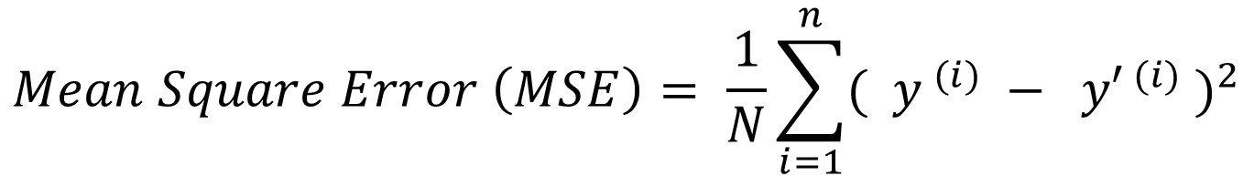
Model Evaluation Measures (Regression)
GPA | Salary (thousands) y | Model 1 y’ | Model 2 y’
3 | 40 | 35 | 39
3.2 | 45 | 45 | 44
3.5 | 50 | 55 | 48
3.8 | 80 | 75 | 82
$$Mean Square Error \left(MSE\right)= \frac{1}{N}\sum_{i=1}^{n}{{( y^{ (i)} − {y′}^{ (i)} )}^{2}}$$

Slide 28
Q & A

Slide 30
Basic Notations

Slide 31
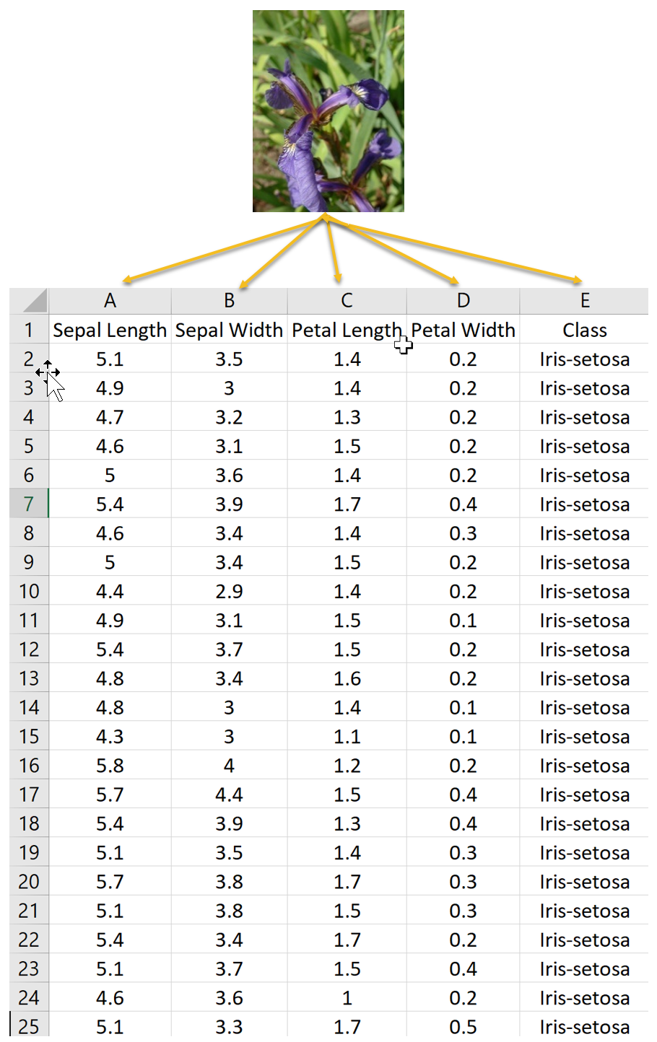
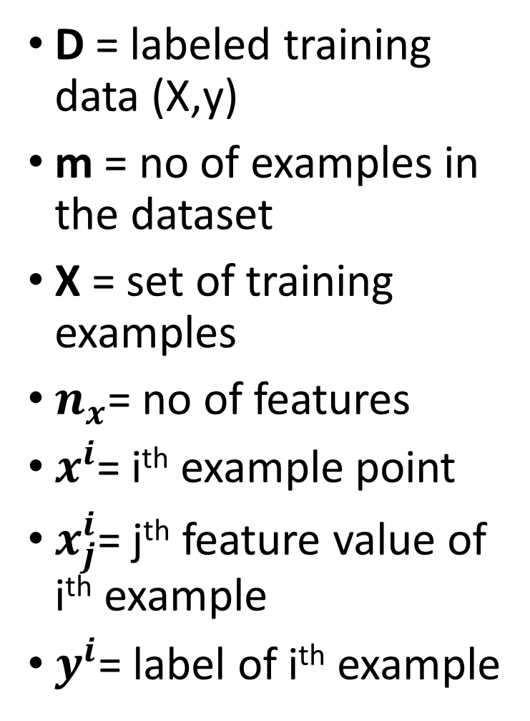
D = labeled training data (X,y)
m = no of examples in the dataset
X = set of training examples
$n_{x}$= no of features
$x^{i}$= i^{th} example point
$x_{j}^{i}$= j^{th} feature value of i^{th} example
$y^{i}$= label of i^{th} example

Slide 32
Advantages and Disadvantages of Supervised Machine Learning

Slide 33
Advantages of Supervised Learning
With the help of supervised learning, the model can predict the output on the basis of prior experiences.
In supervised learning, we can have an exact idea about the classes of objects.
Supervised learning model helps us to solve various real-world problems such as fraud detection, spam filtering, etc.

Slide 34
Disadvantages of Supervised Learning
Requires a lot of effort in the development of labeled data.
Supervised learning cannot predict the correct output if the test data is different from the training dataset.
In supervised learning, we need enough knowledge about the classes of object.

Slide 35
Q & A

